Slide 1
Supply Chain
PRESENTATION

Slide 2
Team
Data preparation ( Ahmed )
Data Modeling and visualization
- Sales Analysis ( Shady )
- Customers Analysis ( Mariam )
- Logistics Analysis ( Mahrous )
- Suppliers Analysis ( Yosra )
- Supply chain Analysis ( Ahmed )
Presentation ( Ahmed - Yosra )

Slide 3
Agenda
Project overview and Objectives
Terms
Data preparation
Analysis Questions
Data Visualization
Key Findings and Suggestions
Q&A

Slide 4
Project overview and Objectives
In this project, we explore a dataset related to supply chain of beauty products consisting of skincare, haircare, and cosmetics. For analyzing and evaluating every stage starting from the acquisition of raw materials or supplies from suppliers to the delivery of final products to customers.
The purpose of the analysis is to understand which part of the supply chain can be improved or optimized to deliver the product more quickly and efficiently to create more value for customers. Additionally, we aim to uncover valuable insights that can drive business growth and competitive advantage.
💡 Some of the fields are not clear to us in the data set.

Slide 5
Terms
Availability: The quantity of each product that is available for sale. refers to the ability to fulfill customer orders
Stock levels: Number of units currently held in inventory at different stages Raw, Semi, and Goods. Refers to there is sufficient stock to meet customer demand without excessive inventory holding costs.
Lead times/ Business lead time: The time required for shipping to the customer.
Lead time/ Supplier lead time: The time required for supplying materials.
Manufacturing lead time: The time required for manufacturing by each SKU.
Transportation modes: The method used by the supplier to deliver goods to the business
Routes: The route used by the supplier for shipment.
Costs/transportation cost: The costs associated with transporting.
Defect Rate / Manufacturing: The percentage of defects found in the products.

Slide 6
the possible grouping of fields.
Product | Logistics | Manufacturing | Customer
Product type | Shipping times | Production volumes | Customer demographics
SKU | Shipping carriers | Manufacturing lead time | Order quantities
Price | Shipping costs | Manufacturing costs | Location
Availability | Transportation modes | Inspection results
Stock levels | Costs | Defect rates
Revenue generated | Routes | Supplier name
Number of products sold | Lead times | Lead time

Slide 7

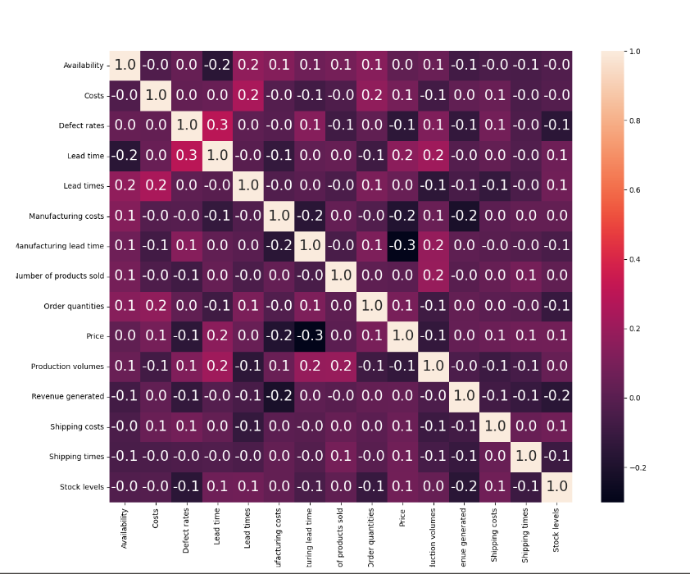
Data preparation
Data Import and Inspection:
Import dataset in CSV format and perform an initial review to understand its structure and content.
💡The 'Revenue Generated' column may not exactly match
the expected product of unit price and quantity sold.
Data Cleaning :
1.Missing Values: Identify and handle missing data.
💡 The ‘Customer demography’ column contains unknown
refers to a lack of information about gender identity.
2.Data Type: Verify that each column is classified with the appropriate data type (numeric, text, etc.).
3.Remove Replicate: Confirm SKU identifiers are unique.
4.Data Require : Add Profit column =
revenue generated - (manufacturing costs + shipping costs + costs)
Descriptive Statistical Analysis:
1.“5 Numbers” analysis: to check outliers for quantitative variables such as Price, Availability, and Revenue, etc.
2.Correlation Matrix : to check correlation between quantitative variables.

Slide 8
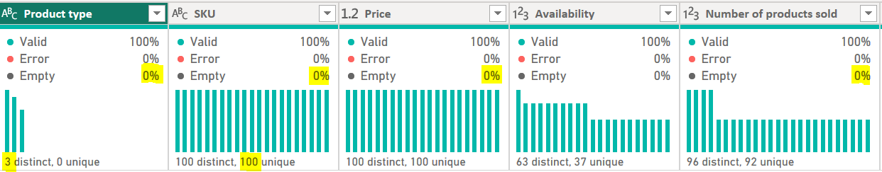
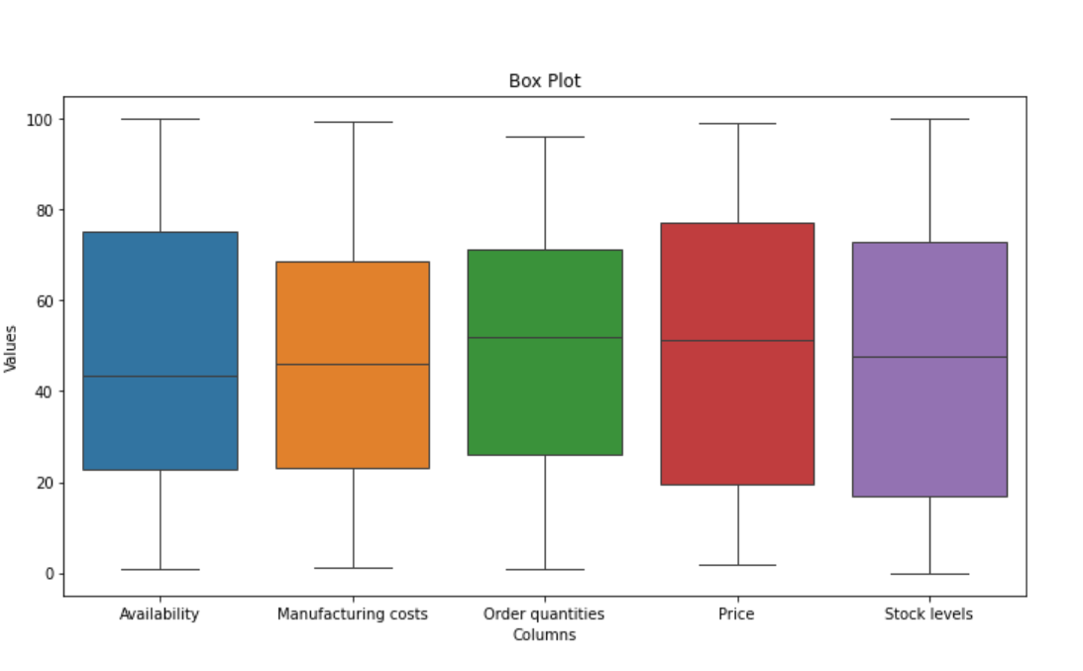
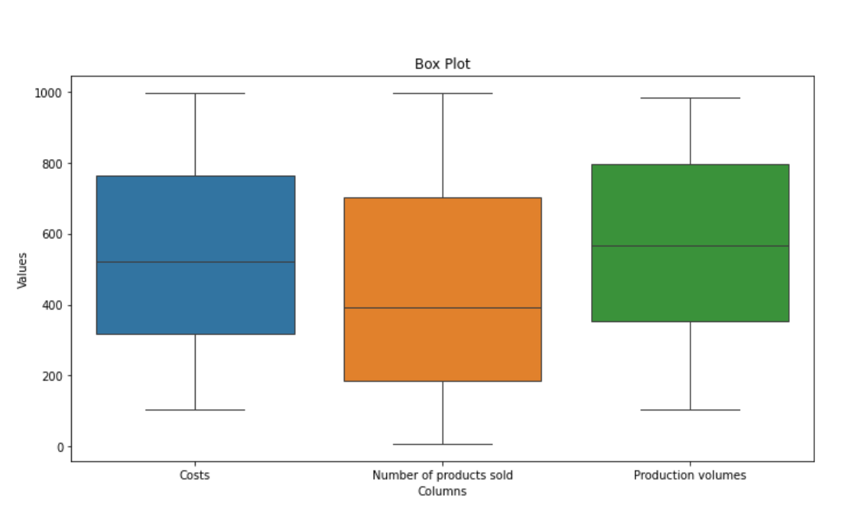
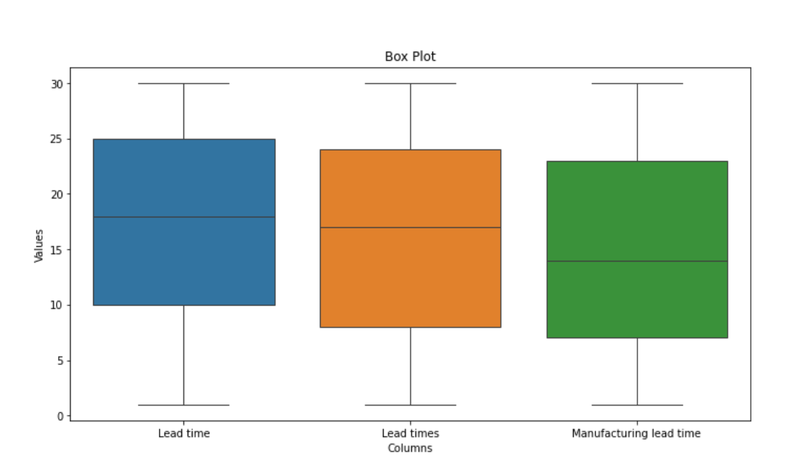
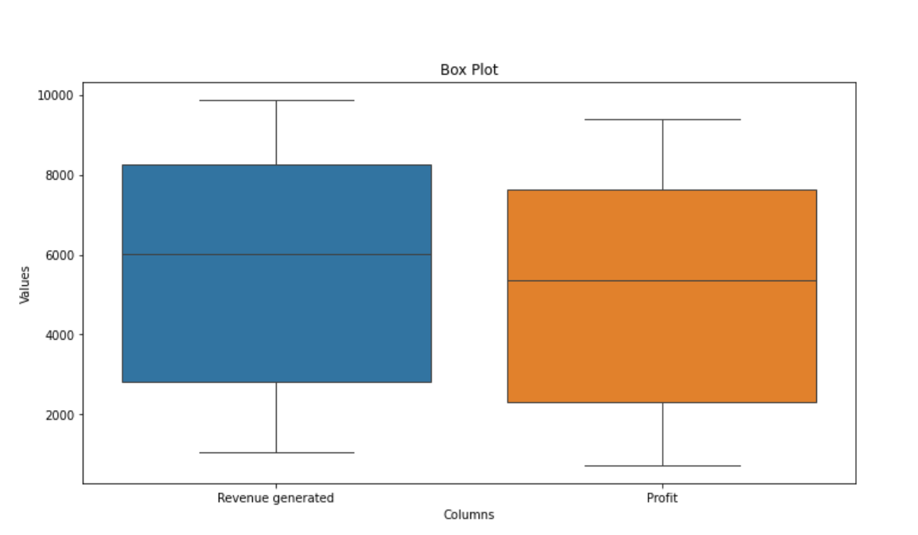
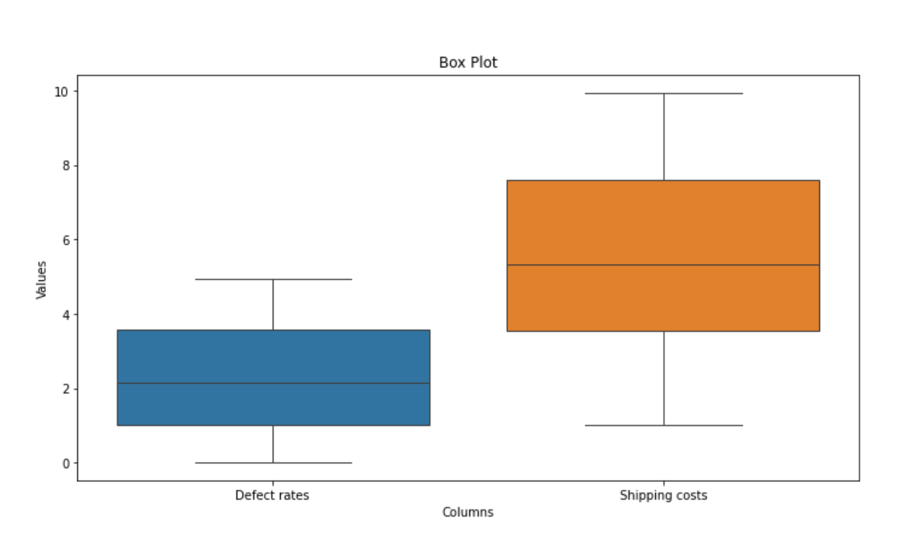

Slide 9
Analysis Questions
Sales Analysis
1.Identify top-selling products on profit.
2.Identify the impact of pricing on sales.
3.Identify products with high and low profitability
Customer Analysis
4.Identify customer purchasing behavior.
5.Identify customers demographics per location.
Supplier Analysis
6.Evaluate supplier performance based on product quality, lead time and defect rate in manufacturing.
7.Analyze product defection rates for each type and SKU.
Logistics Analysis
8.Evaluate the efficiency of different carriers, shipping routes and transportation modes.
Supply Chain Analysis
9.Evaluate the efficiency of orders fulfillment by track Lead Times and Manufacturing Lead Time for potential delays.
10. Evaluate the efficiency of orders fulfillment by compare orders QTY against availability and stock levels .
.

Slide 10
Data Visualization
supply chain of Makeup products

Slide 11
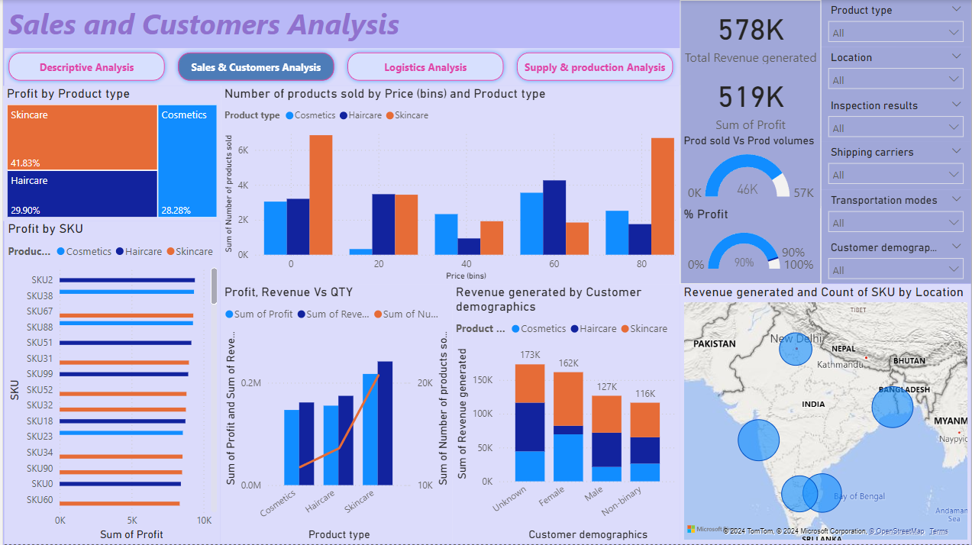

Slide 12
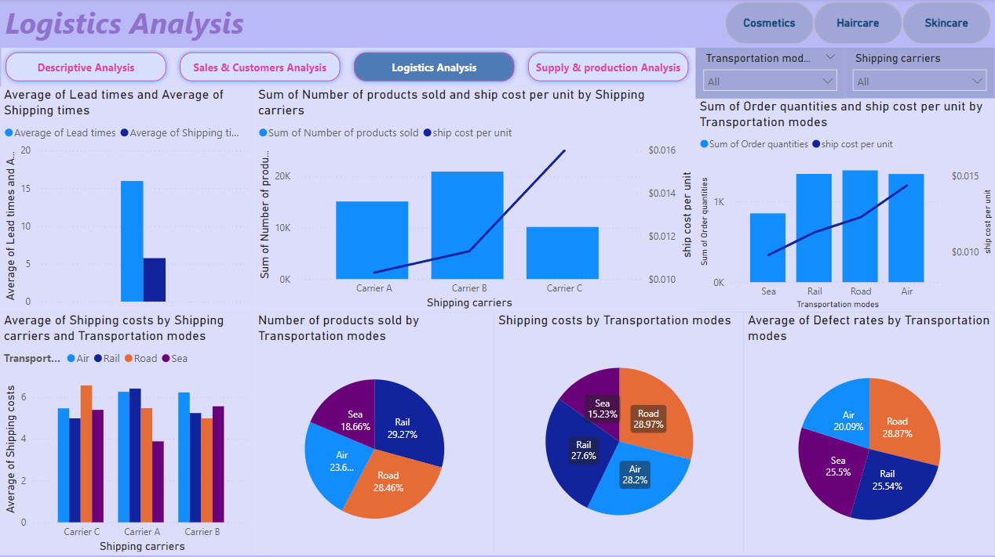

Slide 13
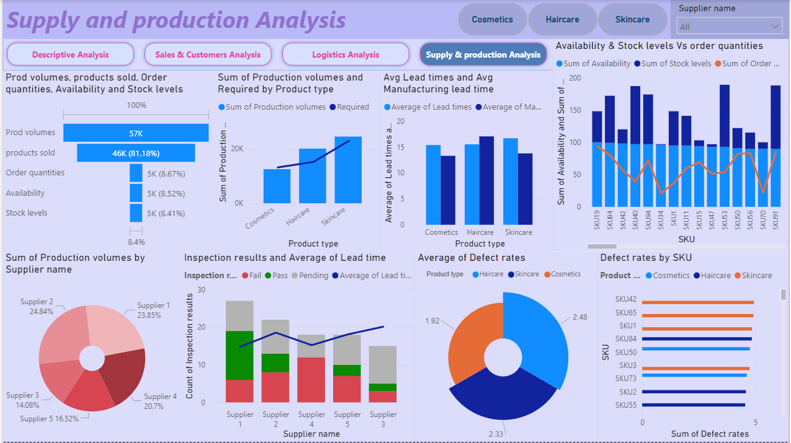

Slide 14
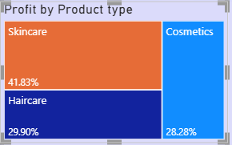
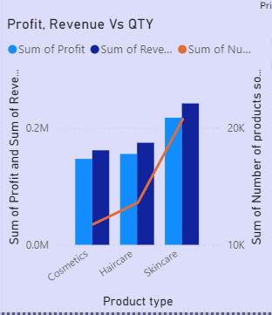
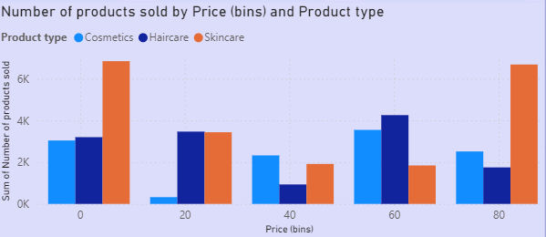
Key Findings and Suggestions
Sales:
Skincare products are the bestsellers 42 % of profit.
Cosmetic products have a high revenue-to-quantity ratio.
The highest profit comes from SKU2, SKU38, SKU67, SKU88, and SKU51, while the lowest revenue comes from SKU59, SKU78, , SKU86 , SKU91 and SKU75.
Positive impact the price of product for skincare with price between 0 – 20 and 80 – 100 on Qty and Revenue.

Slide 15
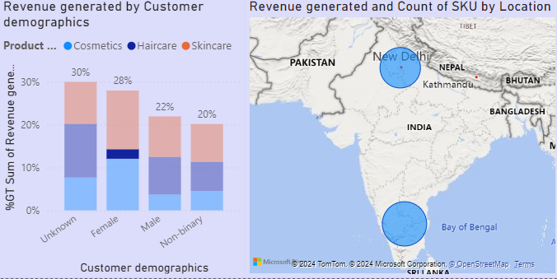
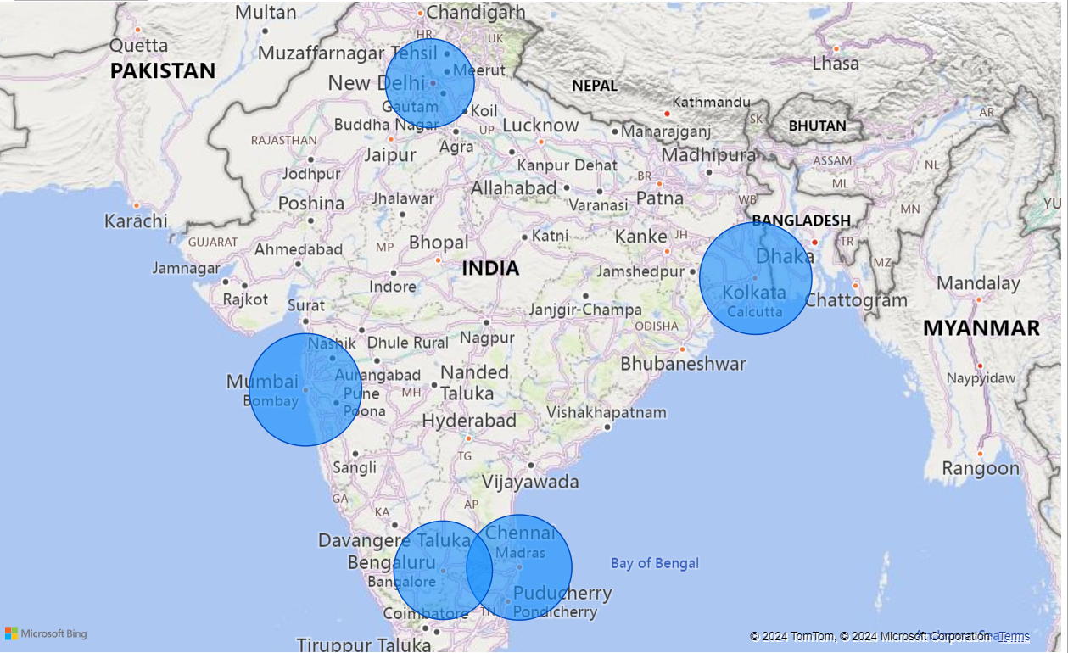
Key Findings and Suggestions
Customers:
30% of the observations doesn't have the gender data.
The highest revenue comes from "unknown" customers, followed by female, male, and non-binary.
Female are mainly purchased skincare and cosmetics vs haircare, while male are purchased skincare and haircare products vs cosmetics due to lack of distribution.
Cosmetics SKUs with price from 20 – 40 distributed only in Mumbai
5. The highest revenue comes from Kolkata and
Mumbai good selling markets. And New Delhi having
lowest selling of products. Company needs to be
understand why this city having less selling
Does any more campaigns or advertisements is
required for customers attention ?

Slide 16
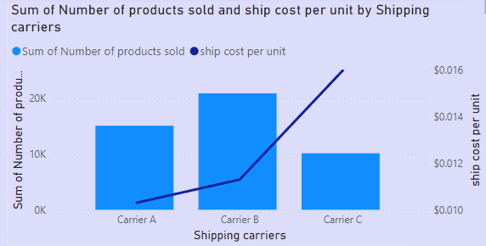
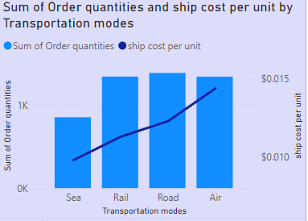
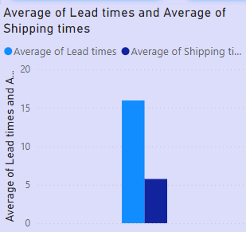
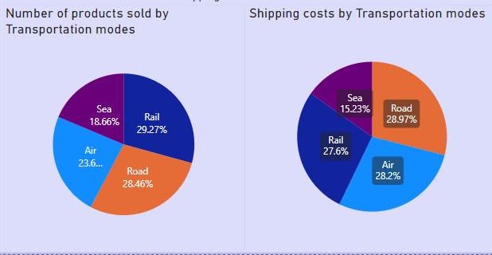
Key Findings and Suggestions
Logistics:
The lowest cost of shipping unit comes from carrier A, followed by carrier B and carrier C, while company shipped a lot of product by B.
The lowest cost of shipping unit comes from sea transportation , followed by other modes, although we shipped small of quantity.
We have a gap 10 days between average lead time of order and shipping time.
24% of products shipped by air around 28 % of shipping cost resulted in increased costs, We can decide the transport based on the urgency and cost efficiency.

Slide 17
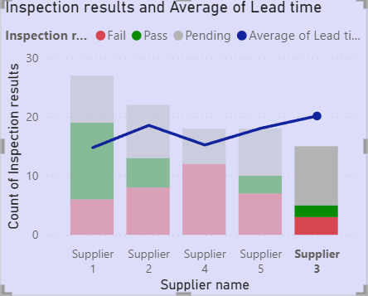
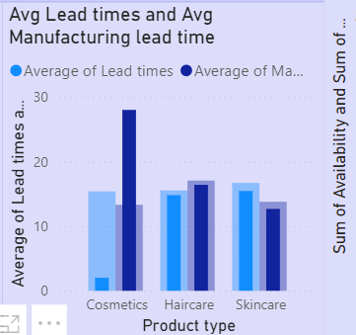
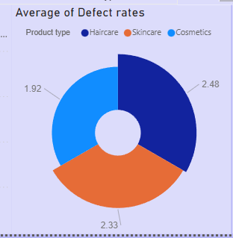
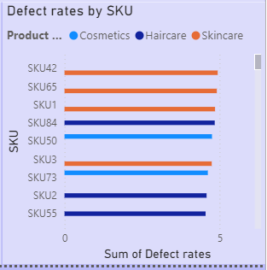
Key Findings and Suggestions
Supplier:
Supplier 1 is the best of all suppliers with the highest % pass.
Supplier 3 takes more time in supplying materials than any other supplier especially 'Cosmetics' items we may re-think before ordering Cosmetics items from supplier 3.
Quality materials from supplier 4 are not the best because all received materials are between fail or pending so, we need to stop ordering from this supplier.
The defect rate of skincare and haircare is higher than cosmetics, The highest defects come from SKU42, SKU65, SKU1, SKU84, and SKU50 around 5%, while the defect average is 2.3%. Can the production/procurement team do something to reduce the defects of these products?

Slide 18
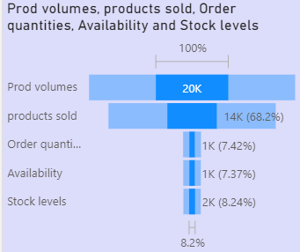
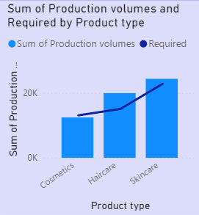
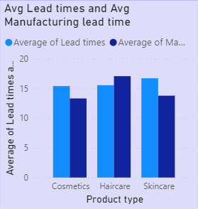
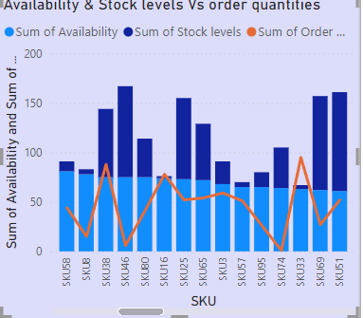
Key Findings and Suggestions
Supply chain:
Overall product sold and order around 90% of production volumes except haircare product sold and order around 15K while production volumes are around 20K, Maybe you need to think about promotion.
Demand for cosmetics more than production volumes need to increase production volumes of cosmetics.
Skincare and cosmetics products have Lead Times more than Manufacturing Lead Time, while haircare products leads to potential delays.
Higher availability and stock level indicate a more efficient and reliable supply chain. The company needs to review SKU 33, SKU2, SKU9, etc. company has orders without available stock suitable.

Slide 19
FINAL TIPS to increase profit
Support sales of cosmetics.
Improve the quality of entry data for gender type.
Spread distribution to cover all cities.
Develop suppliers 3 and 4.
Sync availability and stock level with demand.
Avoid ship by Air as you can.
Prefer carrier A for shipping.

Slide 20
Q&A

Slide 21
THANK YOU

